Slide 1
Outer join
Left, Right, Full

Slide 2
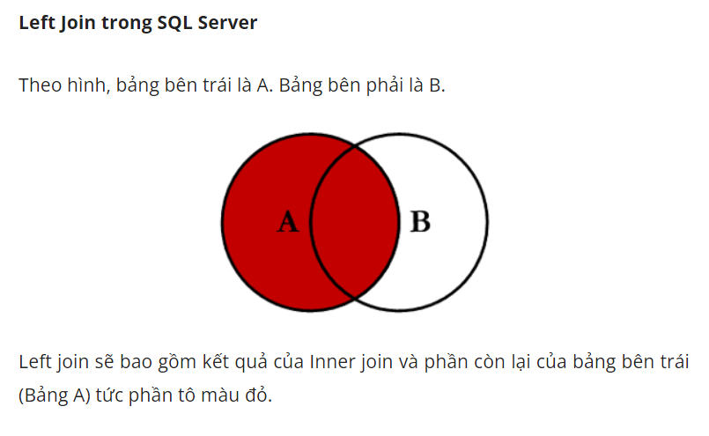

Slide 3
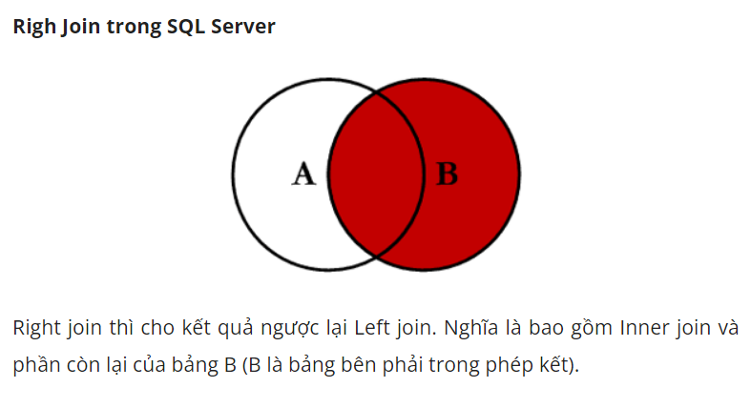

Slide 4
